Slide 1
“Vehicle Theft Intimation Using NodeMCU and GPS Module”
Mini Project – IV
By:
M Suchith 1NH18EC063
Nivedita Salimath 1NH18EC080
Ramya Priya Y 1NH18EC095
Tanmaya H 1NH18EC112
Guided By
Dr. Aravinda K
Associate Professor
Dept. of ECE
New Horizon College of Engineering, Bengaluru

Slide 2
Contents
Introduction
Literature Review
Existing System
Problem Statement & Objectives
Proposed System
Block Diagram
Hardware & Software Specification
Circuit Diagram & Working
Algorithm
Results & Discussion
Advantages & Disadvantages
Conclusion & Future Scope
References
Progress Work
Milestones/Schedule

Slide 3
Introduction
Nowadays with the increasing crime rate, security system for vehicles is also becoming very essential. In most of the cases the vehicle which is stolen is not traceable by the owner of the vehicle.
So, the need of the hour is a better anti-theft-control-system which is implemented in this project using NodeMCU and GPS.
This project uses wireless technology to intimate the owner of the vehicle about any unauthorized entry. This is done by sending an auto-generated SMS to the owner.
In this proposed system if someone tries to forcefully turn on the car, the NodeMCU gets an interrupt and send an SMS to the owner using IFTTT Android message applet.
GPS technology is used to find the exact location of the vehicle.
An additional advantage of this project is that the owner can trigger the NodeMCU to turn off the engine.
Therefore owner of the vehicle from anywhere can turn off the ignition of the vehicle and save his vehicle from theft.

Slide 4
Literature Review
Title of the paper | Author & Year of Publication | Outcome | Limitation
Theft Detection and Engine Lock System using Arduino | K Praveen, G Ravikumar, R Vignesh, M Premakumar and N Revathi April-2021 | Describes about anti-theft detection system and engine lock system using Arduino, GPS and GSM module | It does’nt describes the working and circuit connection in detail.
Vehicle Monitoring and Tracking System using GPS and GSM Technologies | B. Hari Kumar, Syeda Fathima Tehseen, S.Thanveer, Guntha Vamshi Krishna, Syed Mohisin Akram April-2016 | Vehicle security using GSM, GPS and AT89S52 microcontroller and monitoring the status of the engine of the vehicle using thermistor for continuous monitoring of the temperature. | Description about immediate turning off of the engine after sending the message is not mentioned.
Google Assistant controlled Home Automation | Manish Prakash Gupta, 2018 | Provides details on how to use NodeMCU and connect to IFTTT servers for doing certain tasks | Creation of IFTTT applets is not described in detail.

Slide 5
Existing System
Vehicle Theft Control System:
The main objective of this system is to send an auto-generated SMS to the owner of the vehicle about any unauthorized entry. From that SMS owner can find out the exact location of the stolen vehicle by thefts and inform to the concerned authority.
Vehicle Theft Alert & Engine Lock System Using PIC microcontroller:
This system detects if the vehicle is in theft mode and if the status is in theft mode, this system sends SMS to the owner. After which the owner is supposed to send back the message. This message gives command to the vehicle to lock the engine.
Vehicle Theft Identification and Intimation Using GSM & IOT:
In this the vehicle is identified, controlled and connected updates with Internet in a simple way. By utilization of AT commands of GSM module a message will be send to the owner that the vehicle is recognized. Action can be taken by sending a reply to GSM module to stop motor of vehicle.

Slide 6
Problem Statement & Objectives
Problem Statement:
To Alert the Owner of vehicle regarding an Unauthorized entry into the vehicle and help in remote locking of vehicle by an App, and getting exact location Coordinates on SMS.
Objectives:
To design a system which detects an unauthorized entry into the vehicle.
GPS Coordinates data along with alert message is sent to Owner through NodeMCU and IFTTT server.
To Provide Owner, an access to control stopping of vehicle remotely during such situation and provide the location of vehicle.

Slide 7
Proposed System
The main purpose of project is to implement a system which will detect the unauthorised entry to car and will send the SMS and the location to the registered number.
The main two components are GPS module, and NodeMCU esp8266.
NodeMCU has a WIFI module that connects to the internet using the Wifi Network provided. GPS module is a device that receives data from the satellites and obtains the geographical position of the device.
Here the live coordinates received by the GPS receiver module is sent to a mobile phone via SMS using the IFTTT applets like Webhook and Android SMS.
The GPS Coordinates received from the GPS module is sent to the IFTTT server Webhook using NodeMCU and the IFTTT server will send the Alert message and GPS coordinates to the Mobile Number provided.
After owner gets a Alert message he have the option of locking the Engine using Blynk App.

Slide 8
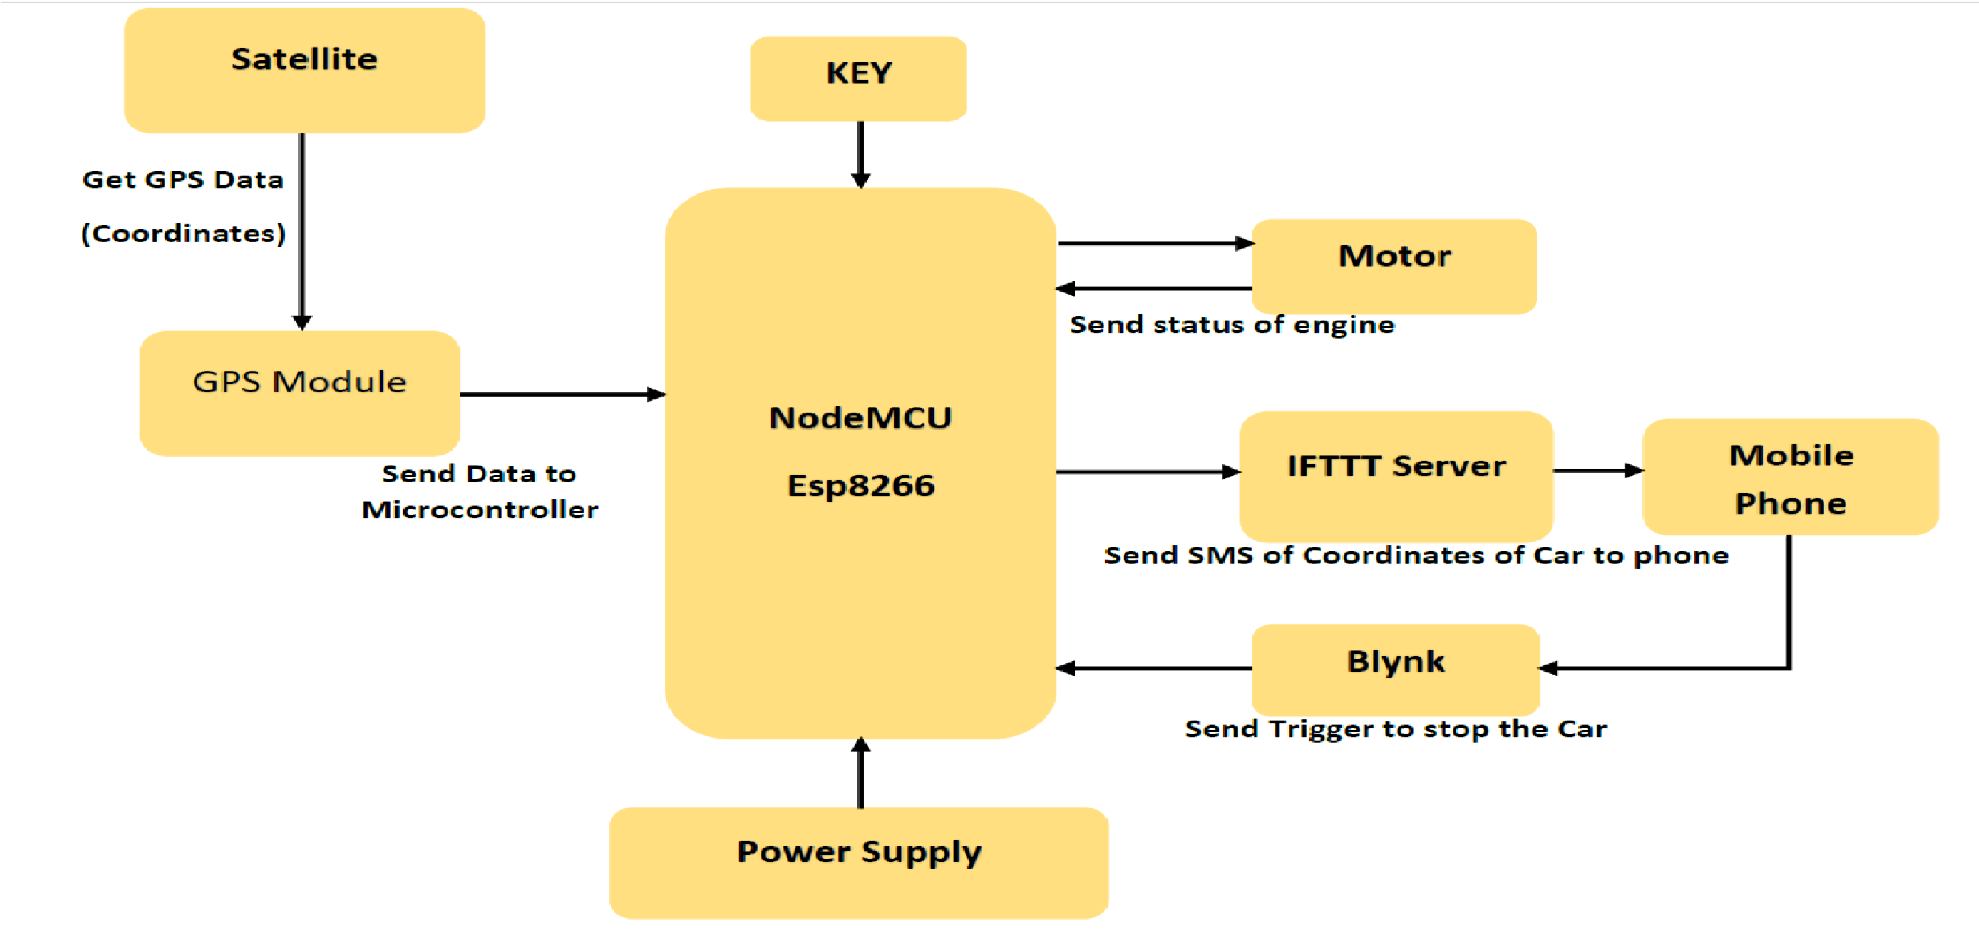
Block Diagram
Block Diagram

Slide 9

Hardware & Software Specification
Software Specification:
Arduino Software (IDE): The Arduino Integrated Development Environment (IDE) is a cross-platform application that is written in functions of C and C++.
It is used to write, compile and upload programs to the Arduino Boards and few other third party microcontrollers and modules which support the Arduino software.
Developers: Arduino Software
Software version used : Arduino 1.8.13
IFTTT (If This Than That): It is a free web-based service to create chains of simple conditional statements, called applets. An applet is triggered by changes that occur within other web services such as Gmail, Facebook, Instagram, or Pinterest.
Here we used IFTTT to use Webhook and Android message in chain. For building our project.

Slide 10
Blynk App: Blynk is a platform with IOS and Android apps to control Ardiono, Raspberry Pi, NodeMCU etc. It is a digital dashboard where we can build a graphical interface to the project.
We are using to interface with NodeMCU to control the working of motor.

Slide 11
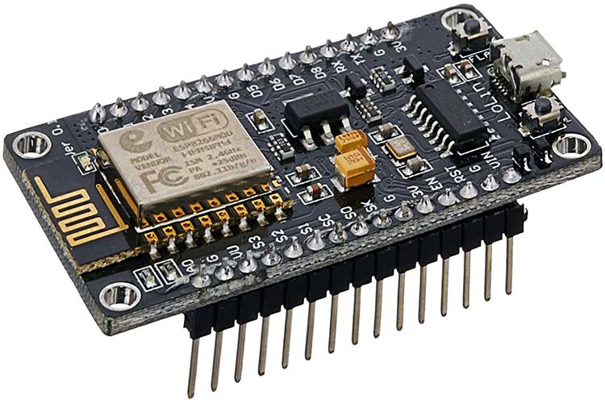
Hardware Specification:
NodeMCU esp8266: NodeMCU is an open-source Lua based firmware and development board specially targeted for IoT based Applications. It includes firmware that runs on the ESP8266 Wi-Fi SoC from Espressif Systems, and hardware which is based on the ESP-12 module.
Microcontroller: Tensilica 32-bit RISC CPU Xtensa LX106
Operating Voltage: 3.3V
Input Voltage: 5-12V
Digital I/O Pins (DIO): 16
Analog Input Pins (ADC): 1
Flash Memory: 4 MB
SRAM: 64 KB
Clock Speed: 80 MHz

Slide 12
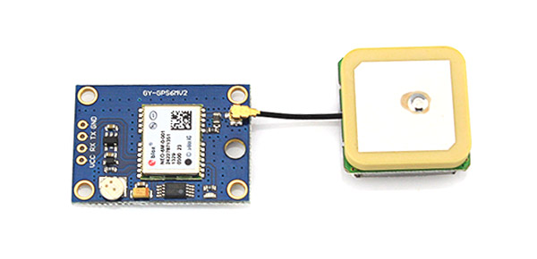
NEO-6M Receiver Module: Global Positioning System (GPS) makes use of signals sent by satellites in space and ground stations on Earth to accurately determine its position on Earth.
The NEO-6M GPS receiver module uses UART communication to communicate with the microcontroller.
It receives information like latitude, longitude, altitude, UTC time. Etc. from the satellites in the NMEA format. This need to be decoded to extract the information that we want to use.
GPS satellites transmit information signal over radio frequency (1.1 to 1.5 GHz) to the receiver.
Power supply:2.7v - 3.6V
Maximum DC current at any output: 10mA
Operation limits: Velocity-500m/s, Altitude-50000m.
Operating temperature range: -40ºC TO 85°C
Library used for config: TinyGPS

Slide 13
Dc motor: A Dc motor converts the electrical energy into mechanical energy. It operates through the interaction between magnetic field of motor and electrical current in the winding to generate force in the form of torque applied on the motors shaft.
We are using Dc motor to demonstrate it as Car’s Engine.
NPN Transistor BC 548: is a general purpose NPN bipolar junction transistor which can be used for amplifying ad switching purposes in electrical circuits.
Based on the voltage applied at the base terminal of the transistor switching operation is performed.
When Vin < 0.7V it acts as open switch.
When Vin > 0.7V it acts as closed switch.

Slide 14
KEY/Push Button: A push button is a simple type of switch that controls an action in a machine or some type of process. Most of the time, the buttons are plastic or metal. It is used with 10k resister.
Led: A light-emitting diode (LED) is a semiconductor light source that emits light when current flows through it. Electrons in the semiconductor recombine with electron holes, releasing energy in the form of photons.
Power Source: Any battery or Power bank can be used to power on the system.
Operating voltage of the system: 5V
We are using a Power bank with output voltage of 5V
External 9V Battery is used to show unauthorized entry to the vehicle.

Slide 15
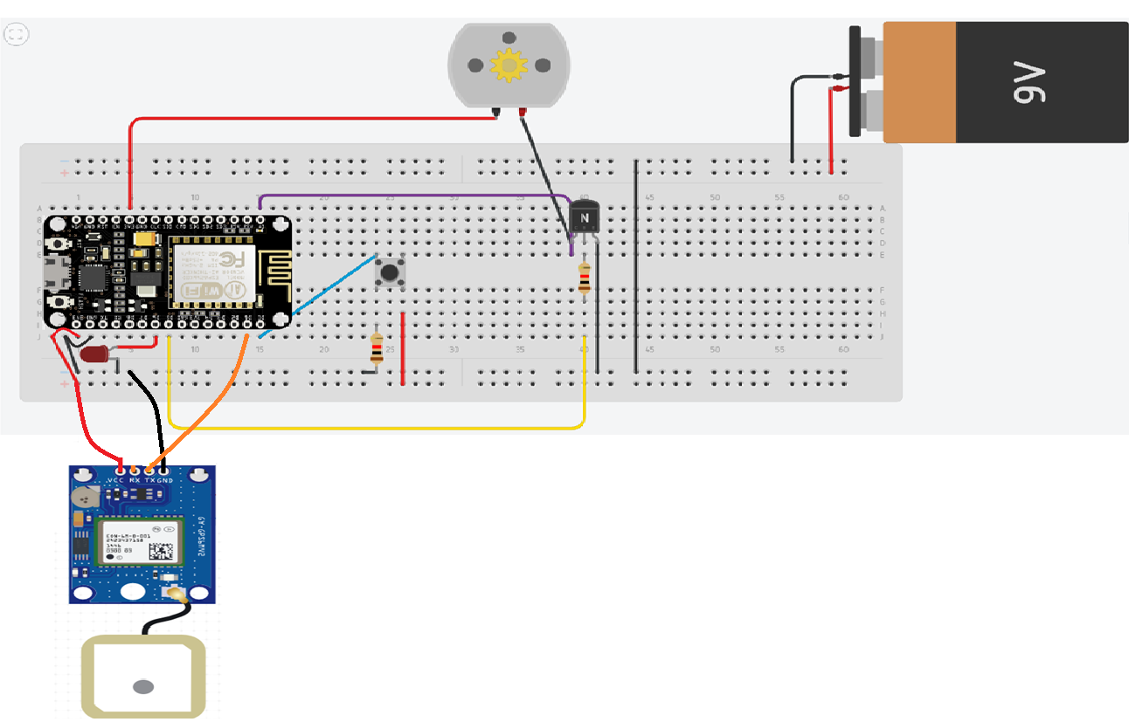
Circuit Diagram & Working
Circuit Diagram

Slide 16
Working
When the device is turned on using power source, NodeMCU will get connected to given WIFI Network and GPS module starts receiving data In the NMEA format.
This NMEA string is decoded into GPS latitude and longitude Coordinates using certain libraries.
When Vehicle is turned ON normally using Key, the motor is either turned ON or OFF based on the status of Key.
When an Unauthorized entry to the car is detected, NodeMCU will start connecting to IFTTT server and make a Webhook request, along with the GPS Coordinates.
This Webhook request will trigger the android message applet to send an alert message to the owner of the Vehicle along with GPS Coordinates.
Now If the owner wants to stop the vehicle, he can use blynk app and click stop button which is configured to send trigger to NodeMCU which will inturn Break the circuit and Vehicle stops.
This will again initiate the Webhook request and owner can now get the exact location of his vehicle to his phone via SMS.

Slide 17
Algorithm
Step 1: Switch on the system GPS and NodeMCU.
Step 2: Get the GPS Coordinates and connect to given WIFI Network.
Step 3: Check the status of Key_status and Flag variables.
Step 4: If ((Key_status == HIGH) && (Flag <=900)) then start the vehicle and check the status of Key_status variable, Stop the vehicle if the Key_status == HIGH again.
Step 5: If ((Key_status == LOW) && (Flag >=900))
Connect to IFTTT server and make Webhook request on IFTTT server which will send an alert message along with GPS Coordinates to the Owner.
Next connect to Blynk server and wait for trigger from the Owner.
If trigger is received, than stop the vehicle and again connect to IFTTT server to make Webhook request which will send the exact location of vehicle to the owner.

Slide 18
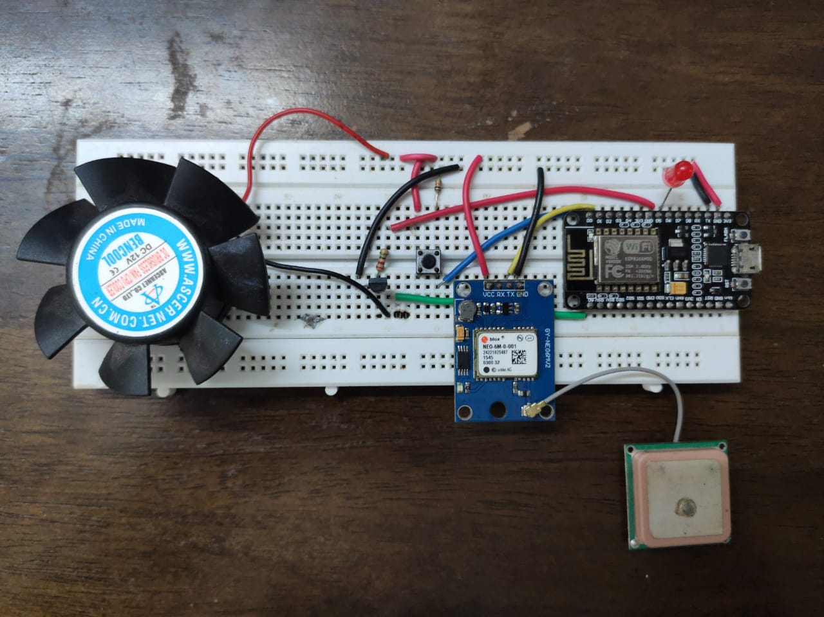
Results & Discussion
The main purpose of this project is to provide a low cost, easy to use tracking and anti-theft engine-lock system. When someone tries to forcefully turn on the car, the NodeMCU gets an interrupt which send an alert message to the owner stating
“Car is in danger”
Coordinates are : latitude, longitude.
Then Owner can remotely stop vehicle by using Blynk App and get location of the vehicle.
Hardware Setup of the project

Slide 19
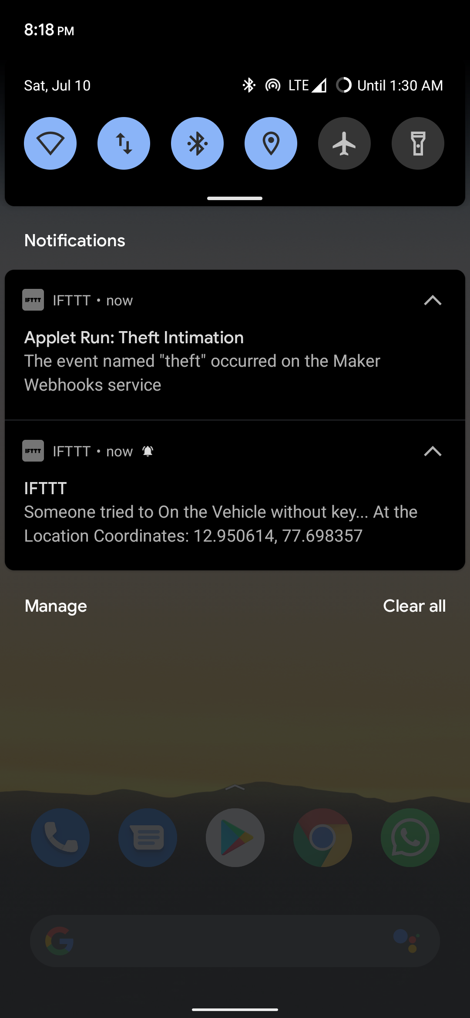
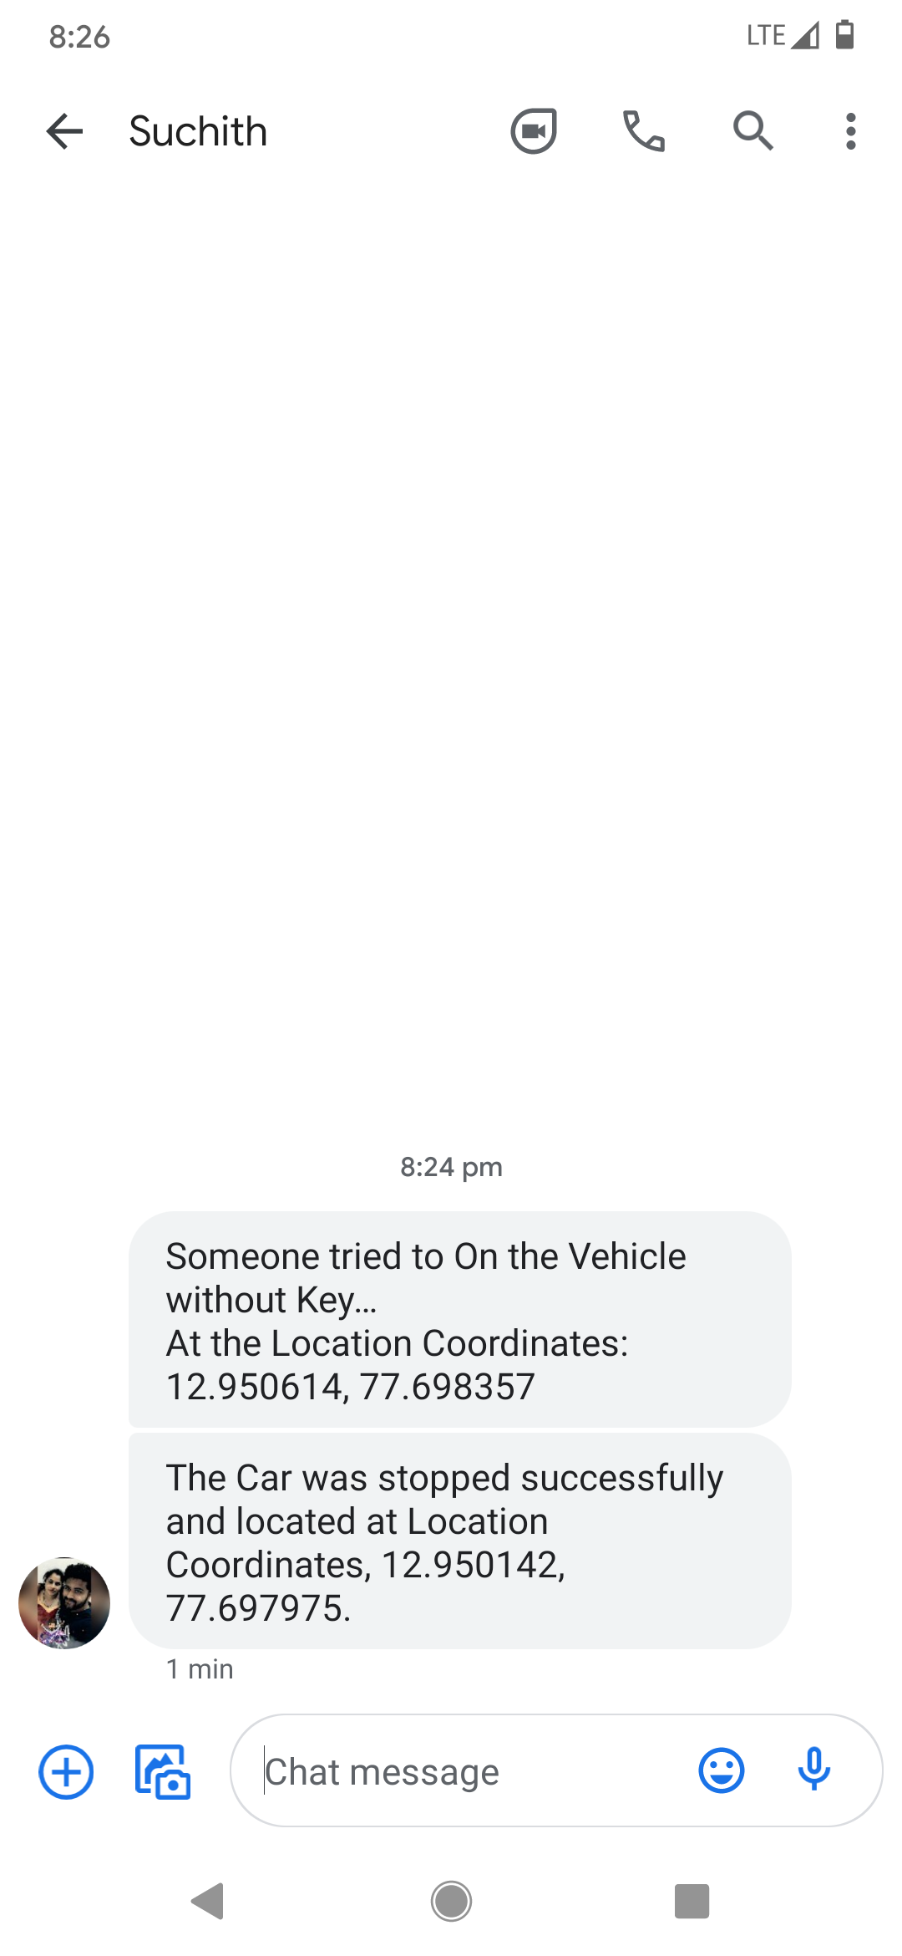
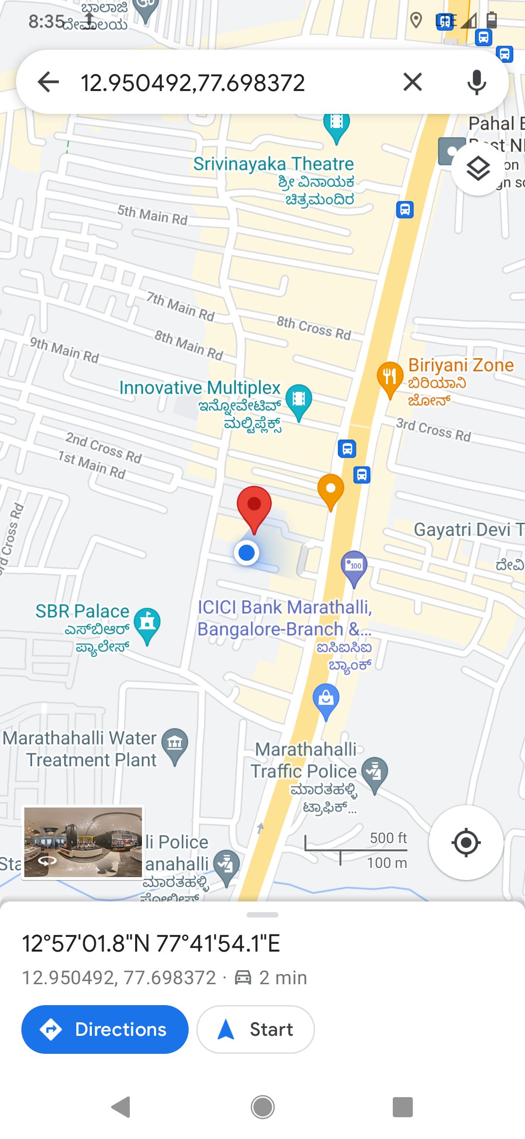
The following are the screenshot of the outputs of the project:

Slide 20
Advantages and Disadvantages
Advantages:
Theft can be stooped while happening itself.
Used in security application.
It is affordable for everyone.
The control will be in Owners Hand.
Since it is using IoT platform we can update the contact very frequently need not change the actual code of the project.
Disadvantages:
Since it uses IoT Platform server crash may affect the system.
Problem in Data Connection will affect.
In Remote Locations, Getting exact GPS Coordinates is difficult.

Slide 21
Conclusion & Future Scope
Conclusion:
The implementation of this system allows safety and security to the vehicles. A simple, cost efficient, anti-theft security system has been successfully designed.
This system helps in tracking exact position of target(vehicle stole by thief) as well as in locking the vehicle through App in perspective of remote control.
Future Scope:
The system can be used to quickly respond to the unexpected accidents which occur on highways or busy roads in cities.
This can be done by arranging these systems in various ambulances which cover the entire city so that the nearest ambulance could be contacted for help.
It can be extended for alcohol detection. The system will detect the driving person whether the person is drunk or not, if the person is taken alcohol, the vehicle will not start.

Slide 22
References
[1] K Praveen, G Ravikumar, R Vignesh, M Premkumar and N Revathi, “Theft Detection and Engine Lock System using Arduino”, IRJET, April 2021.
[2] B Hari kumar, Syeda Fathima Tehseen, S Thanveer, “Vehicle Monitoring and Tracking System using GPS and GSM technologies”, IRJET, April 2016.
[3] Manish Prakash Gupta, “Google Assistant Controlled Home Automation”, IRJET, May 2018.
[4] Baburao Kodavati., V K Raju, S. Srinivasa Rao, A V Prabu, Rao, T. Appa Rao., & Dr Y V Narayana, , “ GSM and GPS Based Vehicle Location and Tracking System”. International Journal of Engineering Research and Applications (IJERA), Volume 01, Issue 03,2013.
[5] Ashad Mustafa, Hassan Jameel, Mohtashim Baqar, Rameez Ahmed Khan Zeeshan M Yaqoob, Zeeshan Rahim, Syed Safdar Hussain , , “Vehicle Intrusion and Theft Control System using GSM and GPS:An Advance and Viable Approach”, Asian Journal of Engineering Science and Technology (AJEST), 2 (2), September 2012.

Slide 23
Progress Work
28 April: MiniProject topics were suited for consideration.
05 May: MiniProject topic was finalized as Vehicle Theft Intimation Using NodeMCU and GPS Module
10 May: Software Installation process was done.
15 May: Hardware Implementation commenced.
18 May: Working on Presentation commenced.
25 May: Presentation for the first review is completed.
30 May: Cicuit was connected as per circuit diagram.
6 June: Coding of NodeMCU was completed.
15 June: IFTTT applet was created and working of circuit was checked ,hardware implementation was completed.
20 June: Started working on report.
5 July: Report work was completed.

Slide 24
Milestones/Schedule
Milestone | Baseline Date | Target Date | Achievement
PowerPoint Presentation | 18/05/2021 | 15/06/2021 | Completed
Writing of Project Code | 10/05/2021 | 20/06/2021 | Completed
Hardware Implementation | 10/05/2021 | 25/06/2021 | Completed
Report | 30/06/2021 | 05/07/2021 | Completed

Slide 25
Thank You

